Slide 1

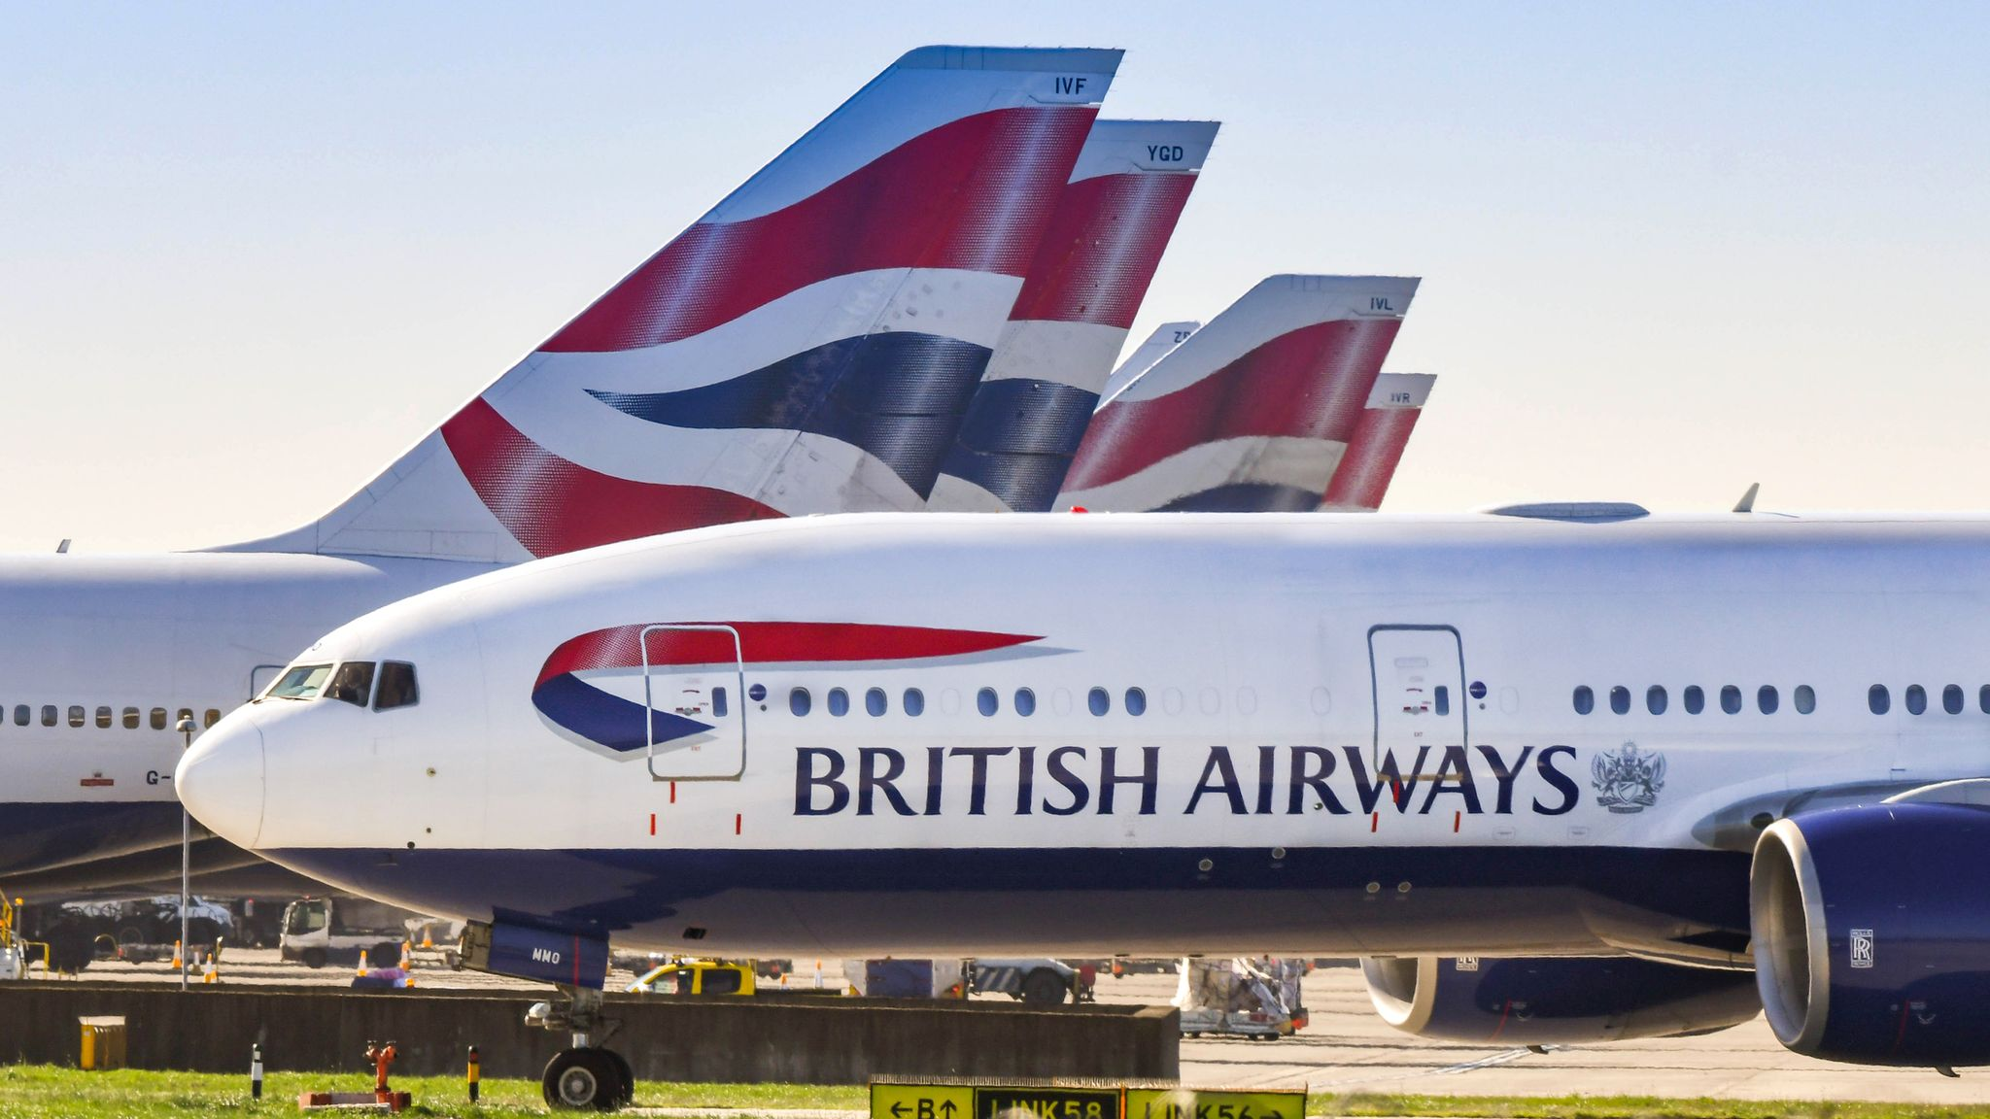
Web scraping to gain company insights
11th of April 2024 Created by: Duneesha Suloshini

Slide 2
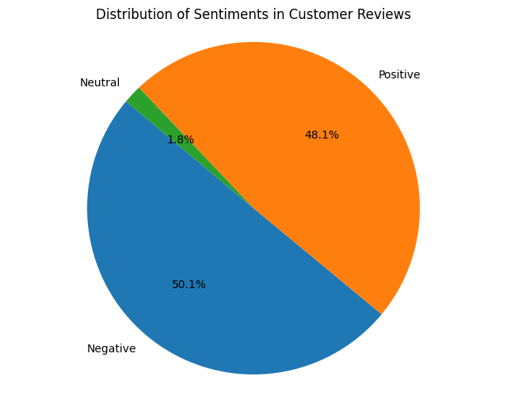
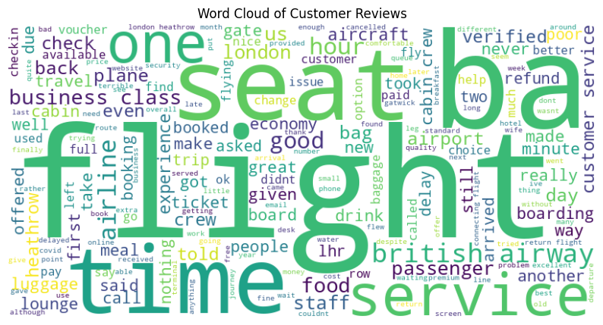
INSIGHTS FROM CUSTOMER REVIEWS
From cleaning 1000 reviews given by the customers, we obtained
Positive Reviews - 481
Negative Reviews - 501
Neutral Reviews - 18
Word cloud of keywords used in reviews

